Slide 1
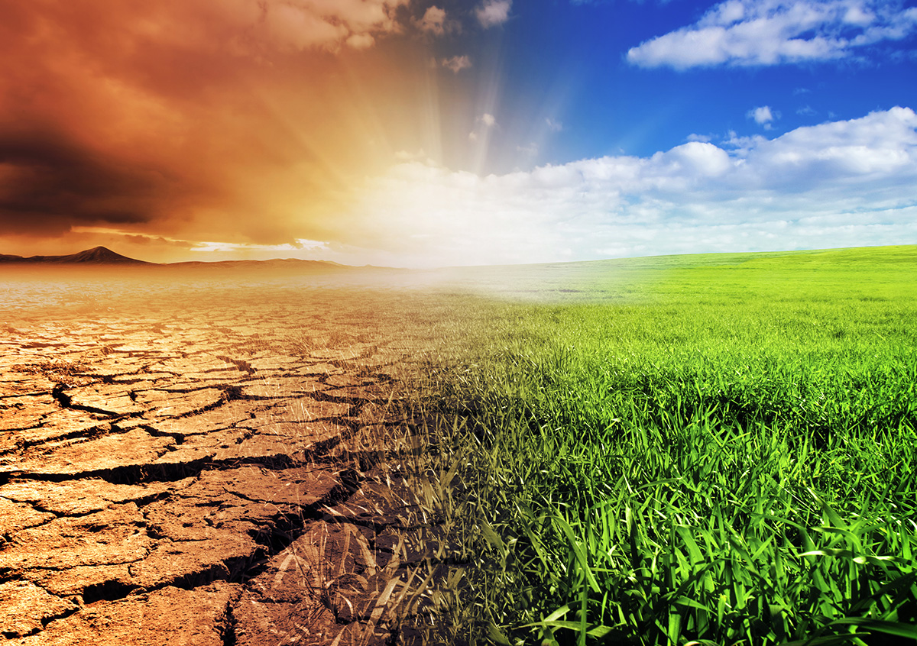
Climate and air

Slide 2
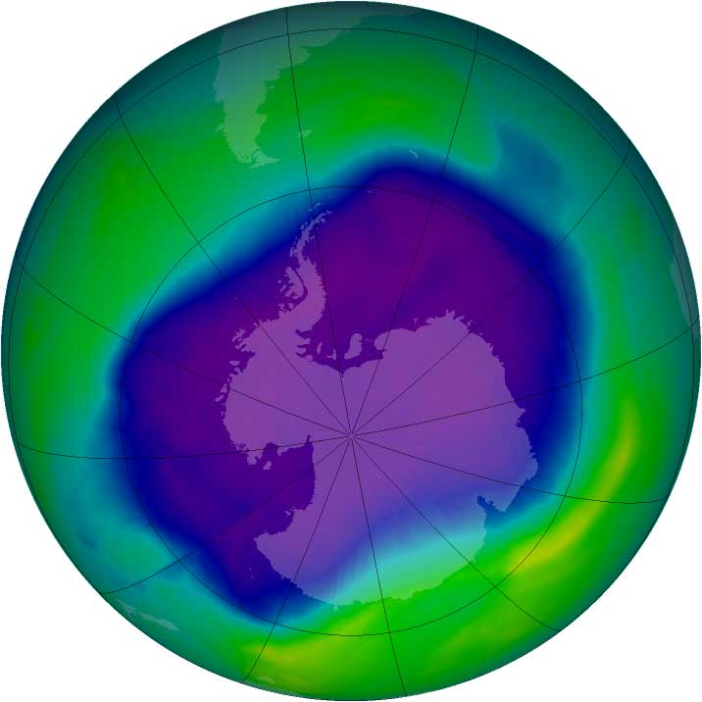
Common air pollutants
Air pollution is caused by suspended particulates and the emission
of harmful gases.
Common air pollutants include:
Sulphur dioxide
Nitrogen dioxide
Carbon monoxide
Ozone and photochemical oxidants
Lead

Slide 3
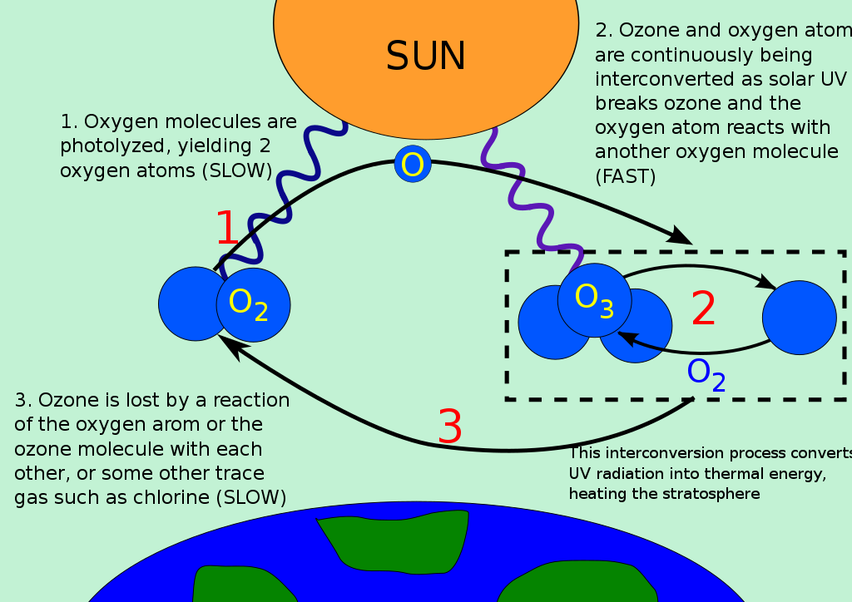

Slide 4
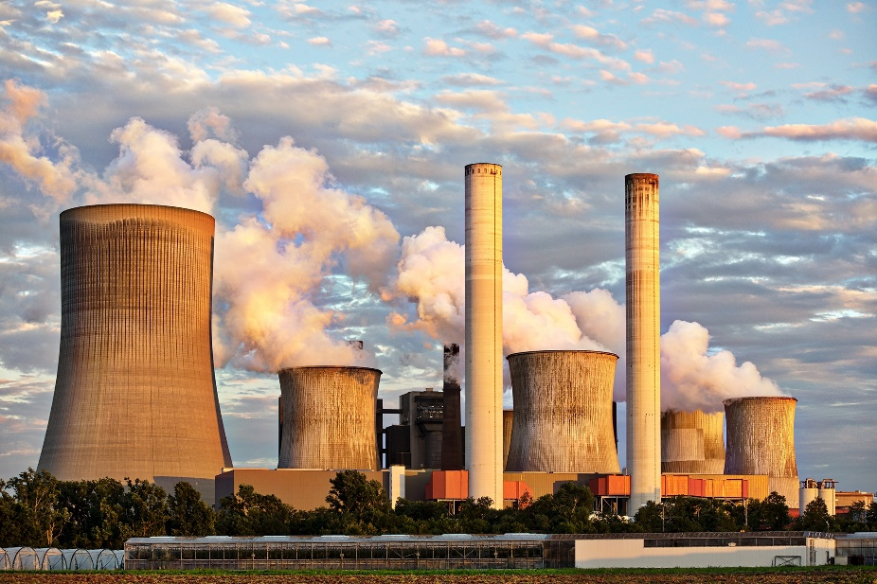
Sources of air pollution
The major sources of air pollution in Hong Kong include various vehicles on the road and power plants. Exhaust fumes from vehicles contain suspended particulates, hydrocarbons and nitrogen oxides; vessels and power plants emit pollutants like Sulphur dioxide and nitrogen oxides.
Hong Kong is also affected by air pollution in neighbouring regions, such as the Pearl River Delta, so Hong Kong’s air pollution is serious in some days due to external factors.

Slide 5

Harm of air pollution
Air pollution can damage health. Children and the elderly with cardiovascular or respiratory problems are more easily affected by air pollution.
Common symptoms include nose and throat irritation, shortness of breath, coughing and chest tightness. When exposed to air pollutants, the condition of individuals suffering from asthma or chronic respiratory diseases can worsen.

Slide 6
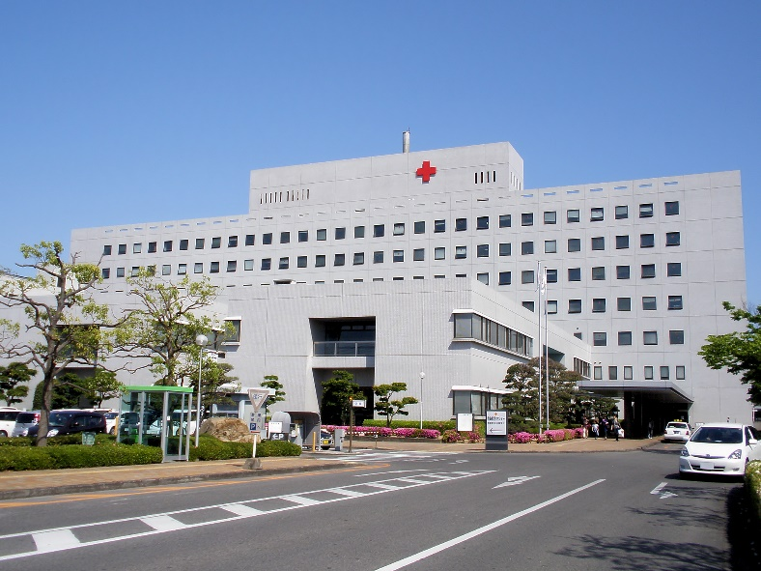
Studies based on local data have shown a strong association between high pollution incidents and both hospital admissions and deaths for respiratory and cardiovascular diseases.
Polluted air also reduces the quality of everyday life. For example, it affects the visibility. In recent years, the visibility in Hong Kong has lowered. Medical expenses are increased on respiratory diseases.

Slide 7
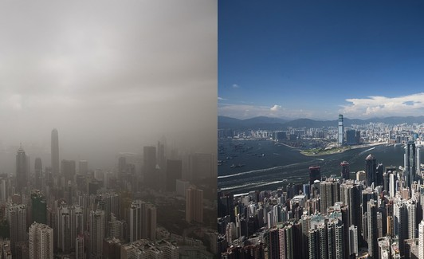

Slide 8
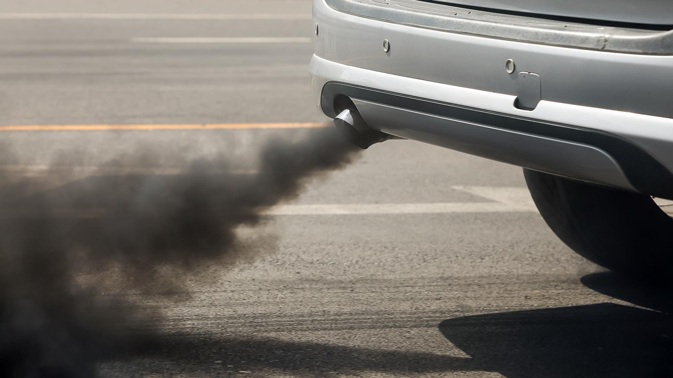
Health problems caused by air pollution
https://www.youtube.com/watch?v=JZx_mRTpSts&t=8s

Slide 9
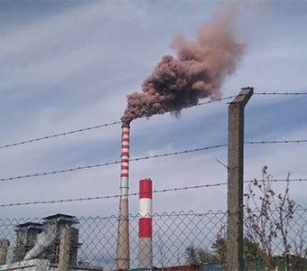
 | Let’s think
How can we protect ourselves from air pollution?
Discuss with your group members
When we go out:
At home:

Slide 10
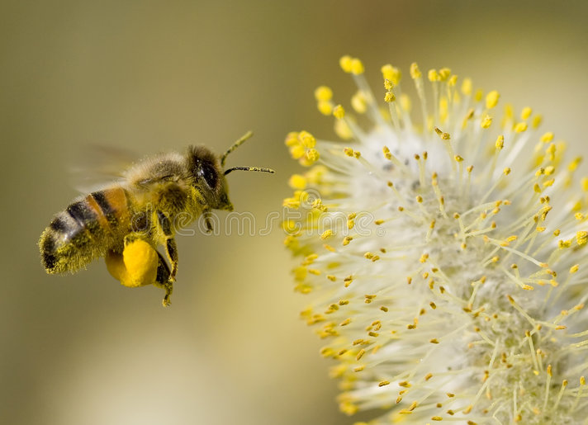
Respirable and fine suspended particulates
Advertisements for air purifiers on the market often contain jargons like PM10 and PM2.5. PM is short of ‘particulate matter’, which refers to pollutants in the air.
PM10 refers to particulates with a diameter under 10 µm (1 µm = 1 thousandth of a millimeter=0.001mm).
They are known as respirable suspended particulates. Examples include pollen and allergens.
µm : Pronunciation :micromolar

Slide 11
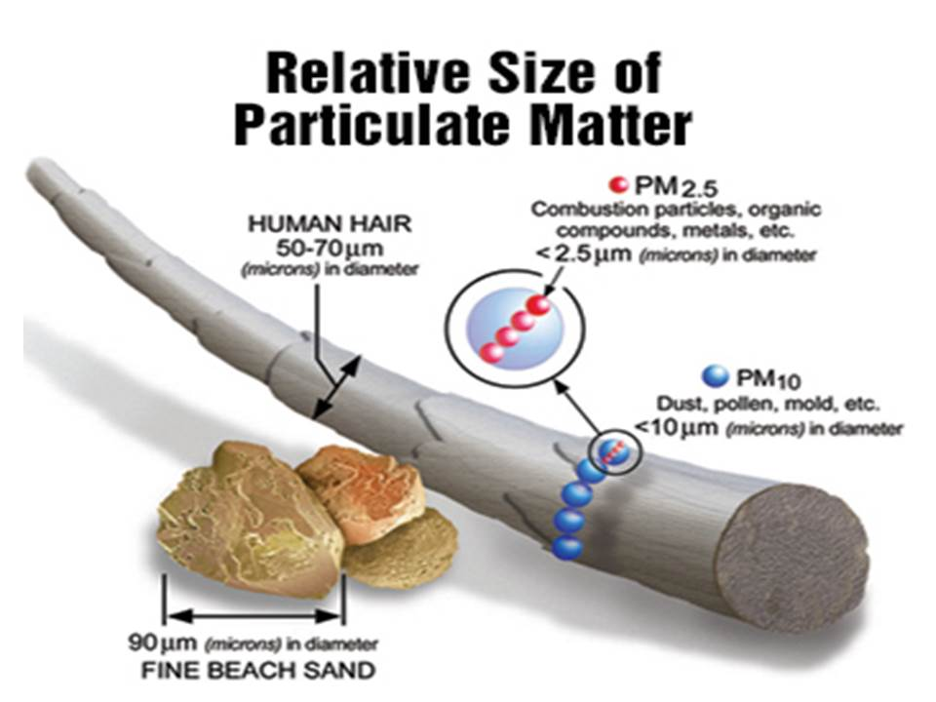
PM2.5 refers to particulates with a diameter under 2.5 µm. They are known as fine suspended particulates.
Examples include particulate matter emitted from cooking processes and power generation.

Slide 12
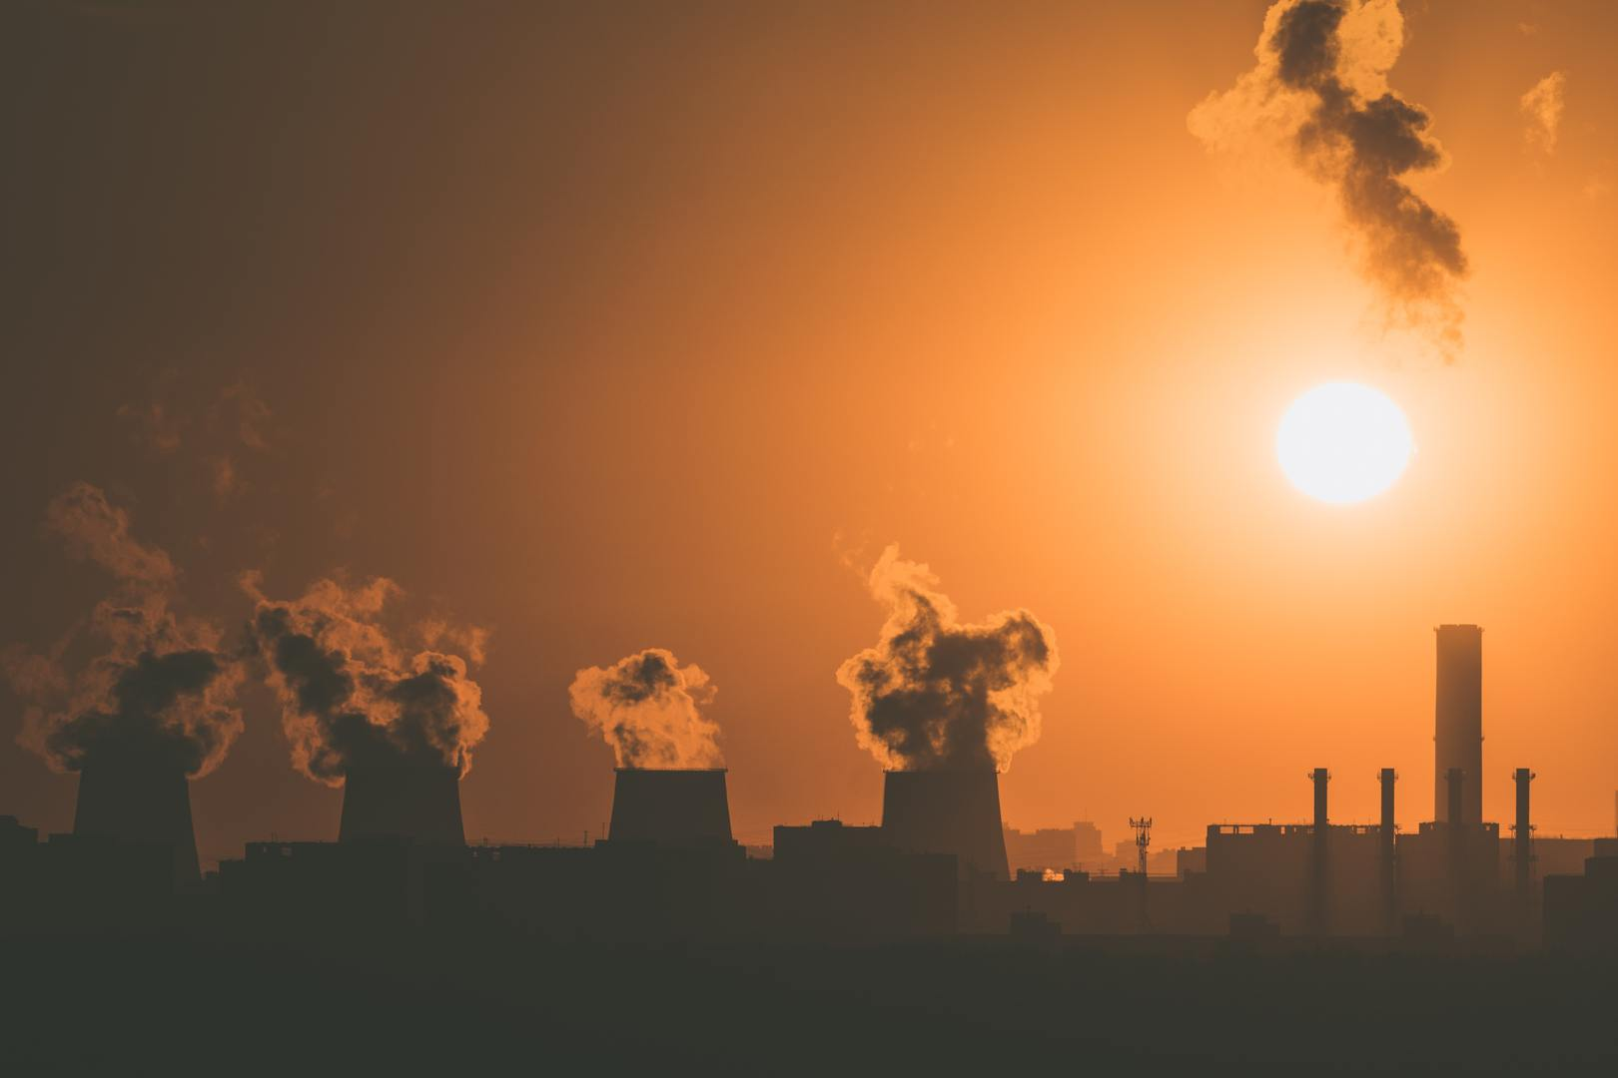
  Pollutants can be categorised into other groups based on size, such as PM5.0 (e.g. bacteria, mould) and PM0.1 (ultrafine particles).
  The smaller the number after ‘PM’, the easier it is for them to attach to harmful substances and enter human organs to affect health.
As buildings in Hong Kong are dense, air
pollutants and allergens cannot disperse easily.
The main function of air purifiers is to trap these particulates to purify the air.

Slide 13

Principle of science experiment
P-Prediction(assumption)
T-Testing(fair testing)
E-Evaluation(explanation of the result)

Slide 14
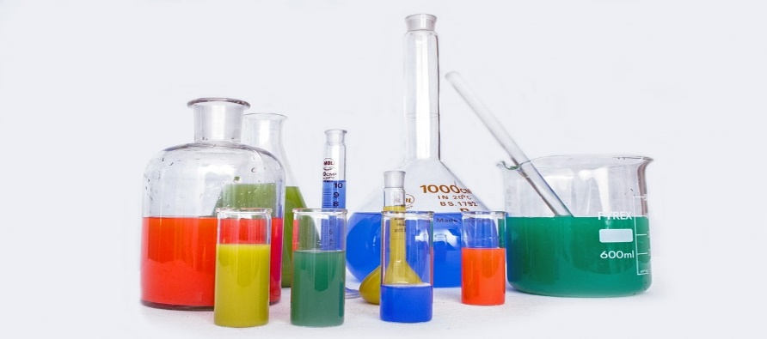
 | STEAM activity
Design an air purifier made from everyday items.
Test the filtering performance of the following materials
 | Test 1
Use the device provided to test the filtering performance
Each group will assign 1 material for testing
Use 3 incenses to accumulate smoke as dirty air
Take 10 readings after the incenses being lit for 2 minutes
List the 10 readings in order(from the largest to the smallest)
Use a Microsoft excel form to calculate the average as the filtering performance
Compare the filtering performance with the control device performance to see which material perform well.
Observe the condition of the material

Slide 15
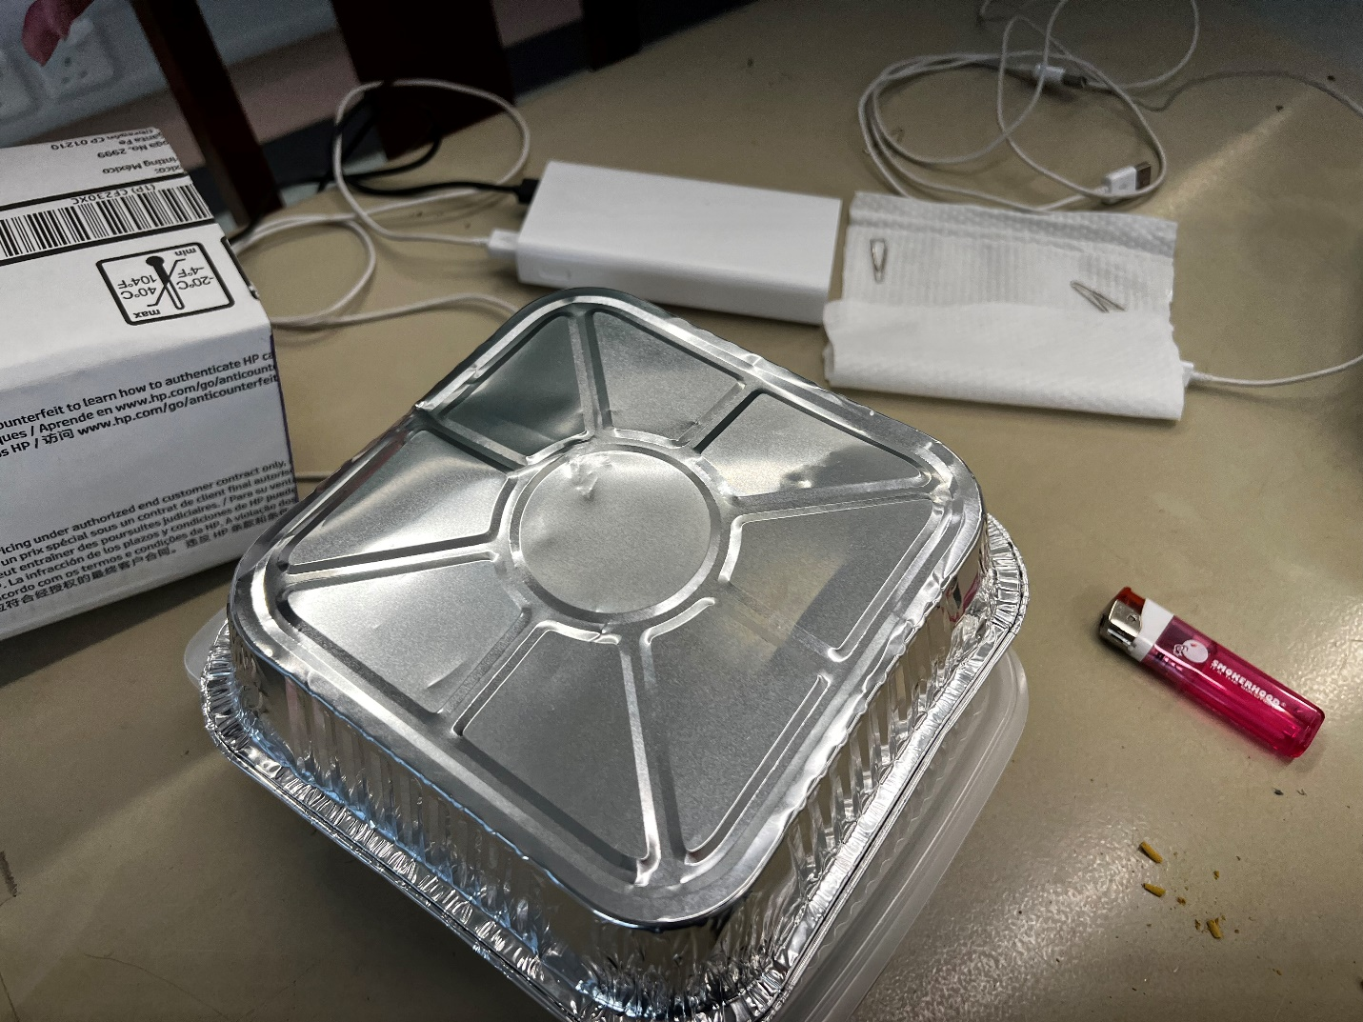
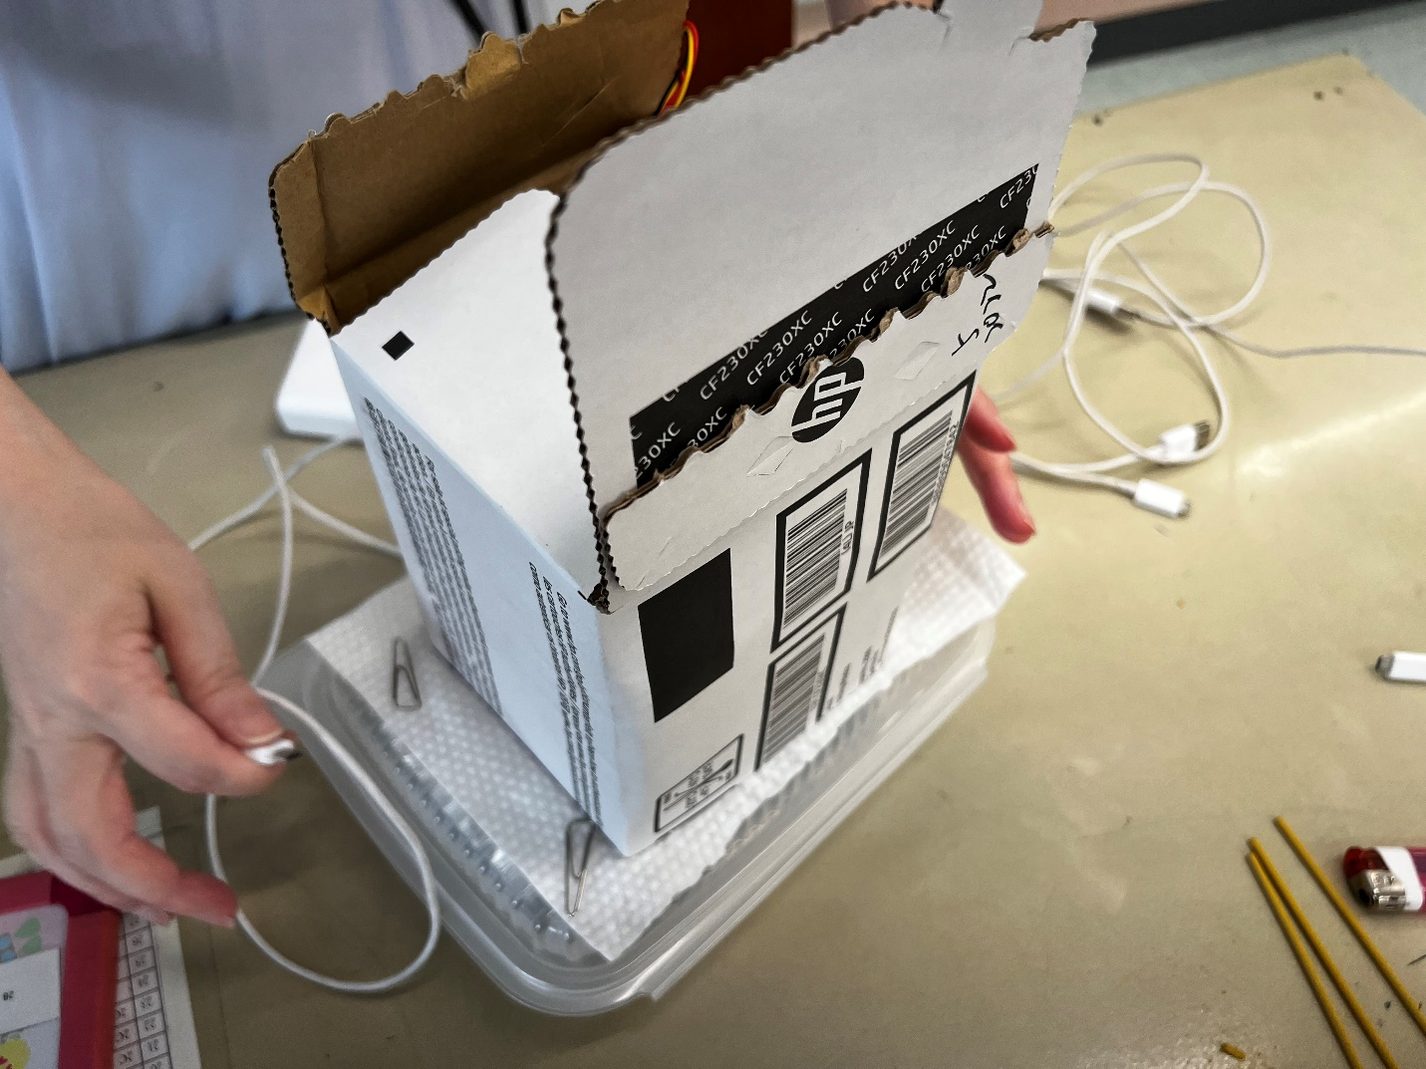
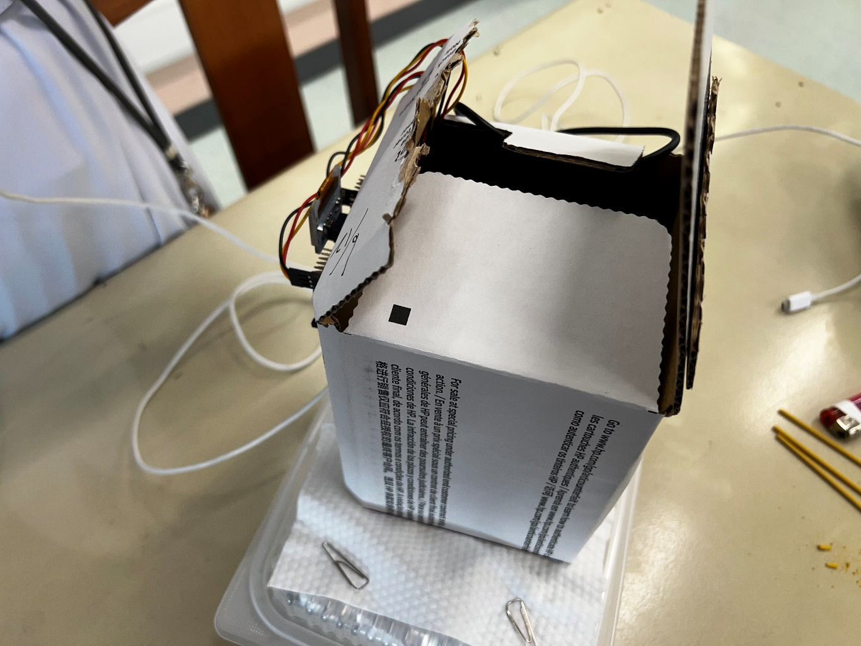
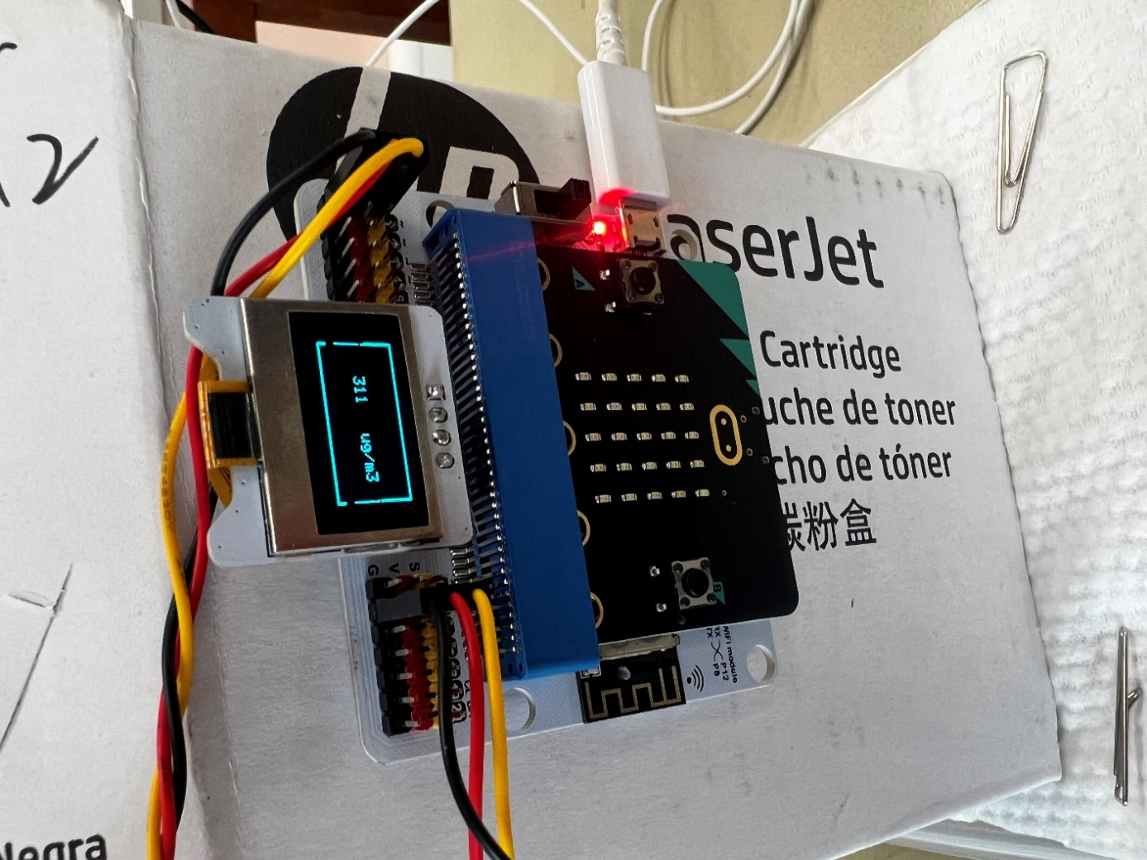

Slide 16


 | Design
Design an air purifier made from the everyday items. Draw the design in the
and label it.
Let’s think
What materials will you use for the DIY filter? Why?
What small home appliance can draw air out?
 | Prediction
What result will you get?

Slide 17
 | STEAM activity
Design an air purifier made from everyday items. Test the filtering performance of DIY air purifier
 | Test 2
Use the device provided to test the DIY air purifier filtering performance
Take 10 readings after the incenses being lit for 2 minutes
List the 10 readings in order(from the largest to the smallest)
Use a Microsoft excel form to calculate the average as the filtering performance
Compare the filtering performance with your prediction
Observe the condition of the DIY filter

Slide 18

 | Improvement
How can you improve the performance of the air purifier?
Discuss with your group members and think about the following points.
Draw your modified design in the box below and point out the modified parts.
Filter materials?
Number of materials?
Layout of the material?
How will you arrange the materials to maximize the performance?

Slide 19
 | STEAM activity
Re-design an air purifier made from everyday items. Test the filtering performance of the DIY filter
 | Test 3
Use the device provided to test the improved DIY air purifier filtering performance
Take 10 readings after the incenses being lit for 2 minutes
List the 10 readings in order(from the largest to the smallest)
Use a Microsoft excel form to calculate the average as the filtering performance
Compare the filtering performance with your prediction and the control device performance
Observe the condition of the DIY filter(can you see yellowish material?)

Slide 20
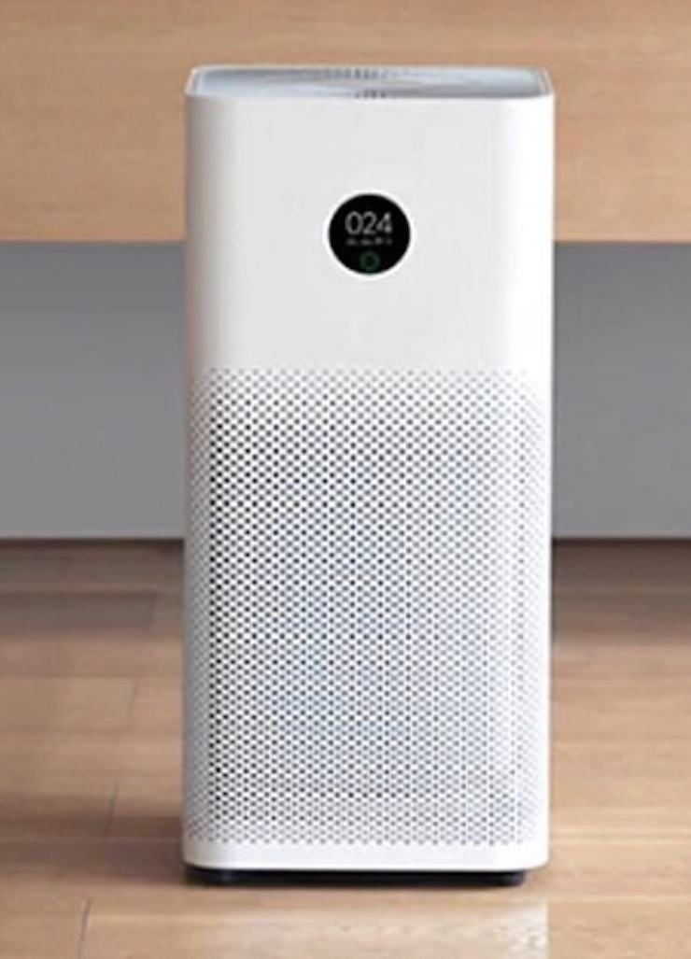
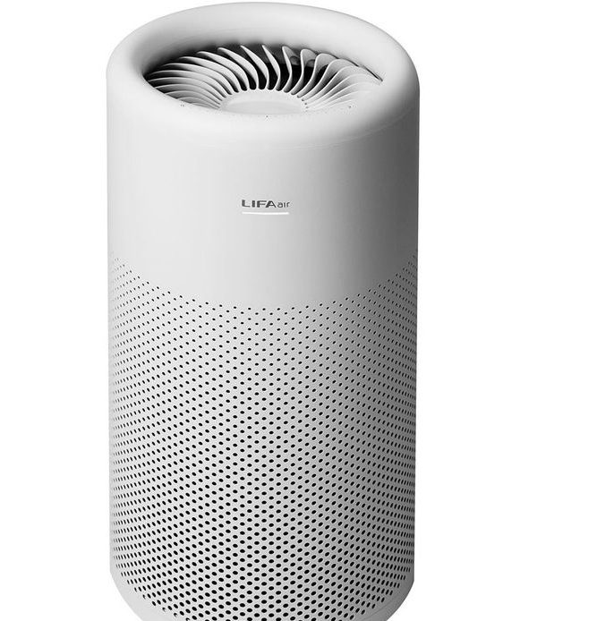
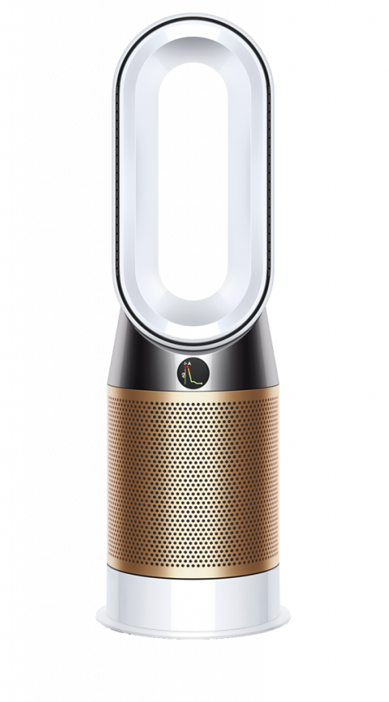
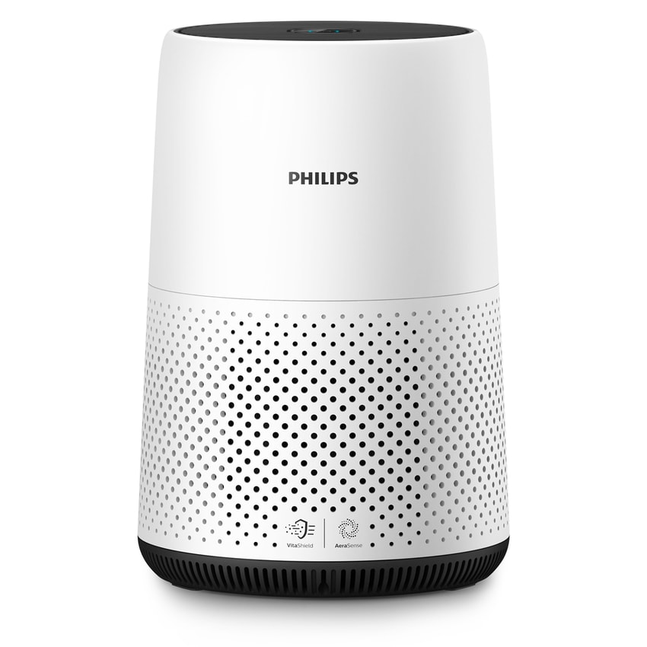
Household air purifier

Slide 21
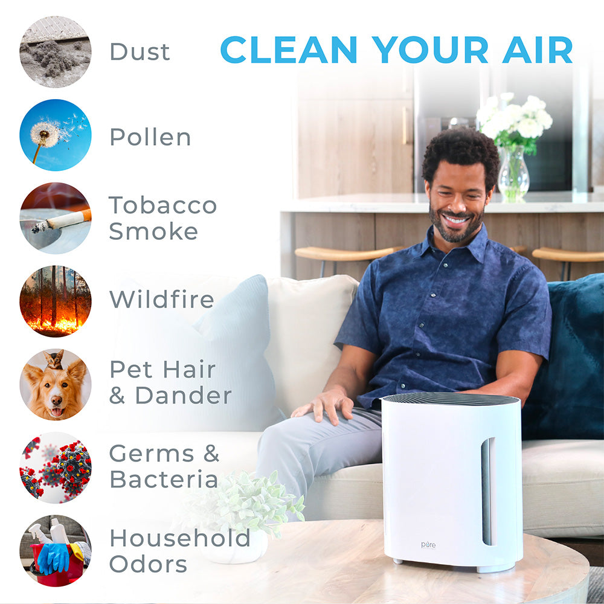

Slide 22
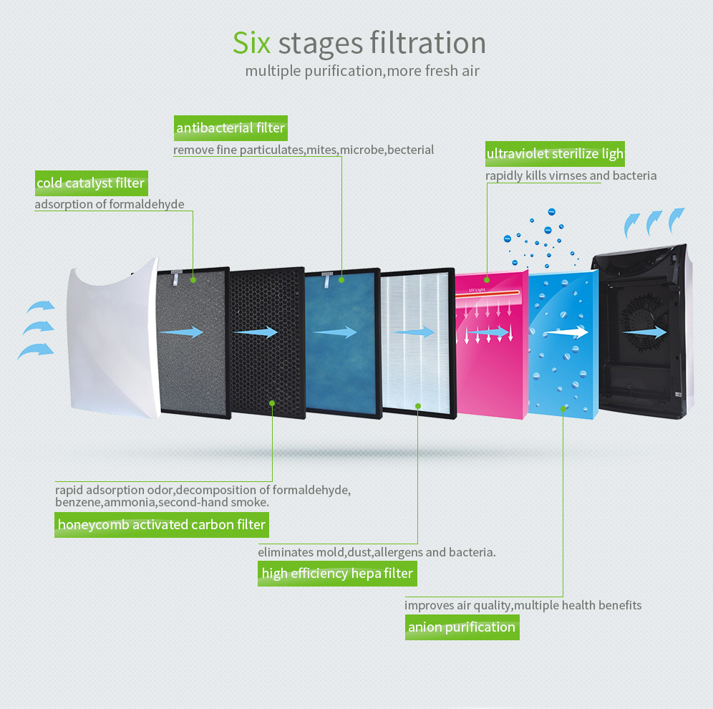

Slide 23

How do air purifiers on the market work? What harmful substances can they filter from the air?
1. Structure of a type of air purifier on the market
Fan to facilitate air movement
Multiple layers of filters made of different materials for filtering different pollutants
Dirty air enters
Clean air leaves

