Slide 1




2024-2025 Quality Education Fund Thematic Network - Tertiary Institutes
Progressive Development of STEAM Literacy through STEAM Education and Self-directed Learning
透過STEAM教育自主學習有序發展STEAM素養
Application of IoT:bit for Data logging
匡智屯門晨崗學校

Slide 2
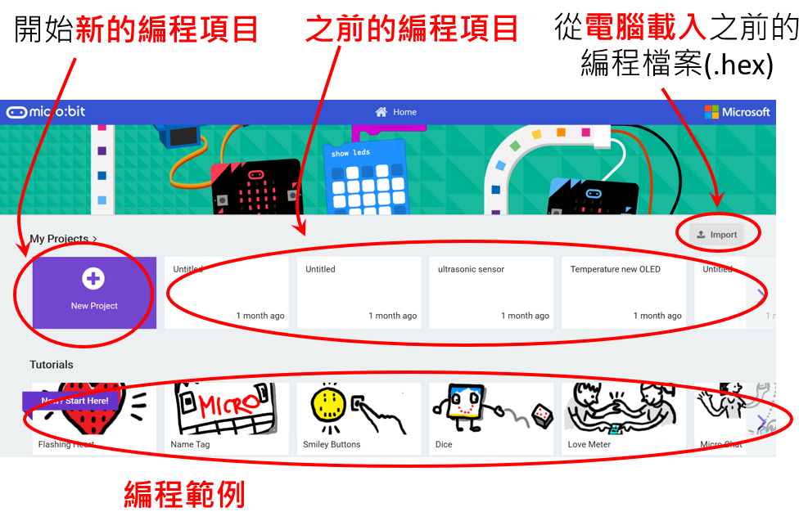
MakeCode 編程平台

Slide 3
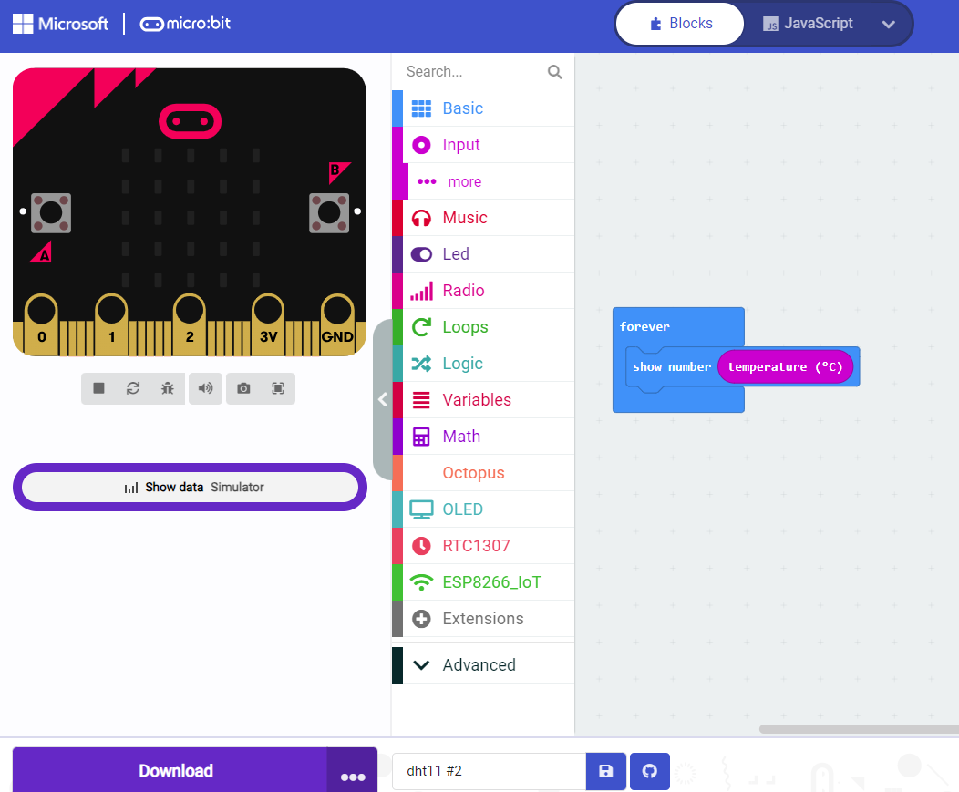







以 MakeCode 編程
我們先以線上版 MakeCode 編程:
https://makecode.microbit.org/
點擊 “+ New Project ”
輸入右面程式碼製作編程
micro:bit 可輕鬆地通過 microUSB 連接線 與 電腦 進行連接， 點擊Download旁邊的3點
按Connect device ，按pair， 選擇要連接的microbit，然後按connect
點擊 “Download” 並把檔案儲存至 “MICROBIT (D:)” 中(micro:bit 可能出現在不同的硬碟中)

Slide 4
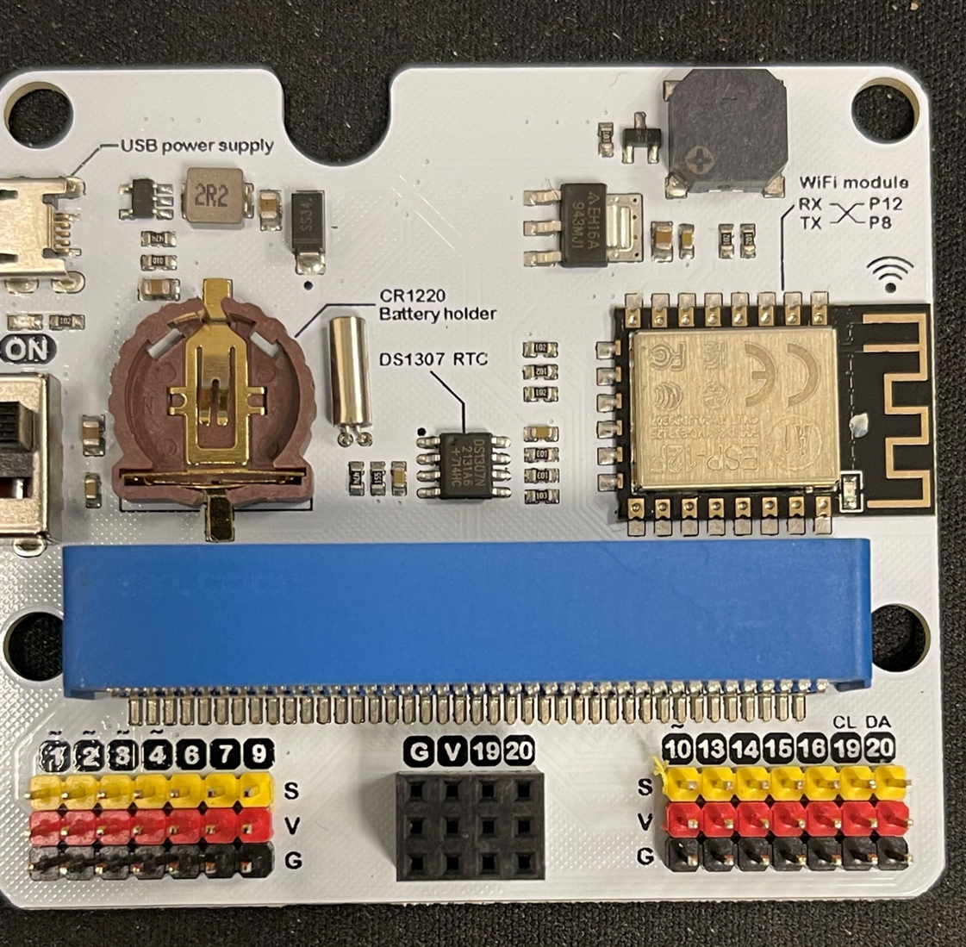
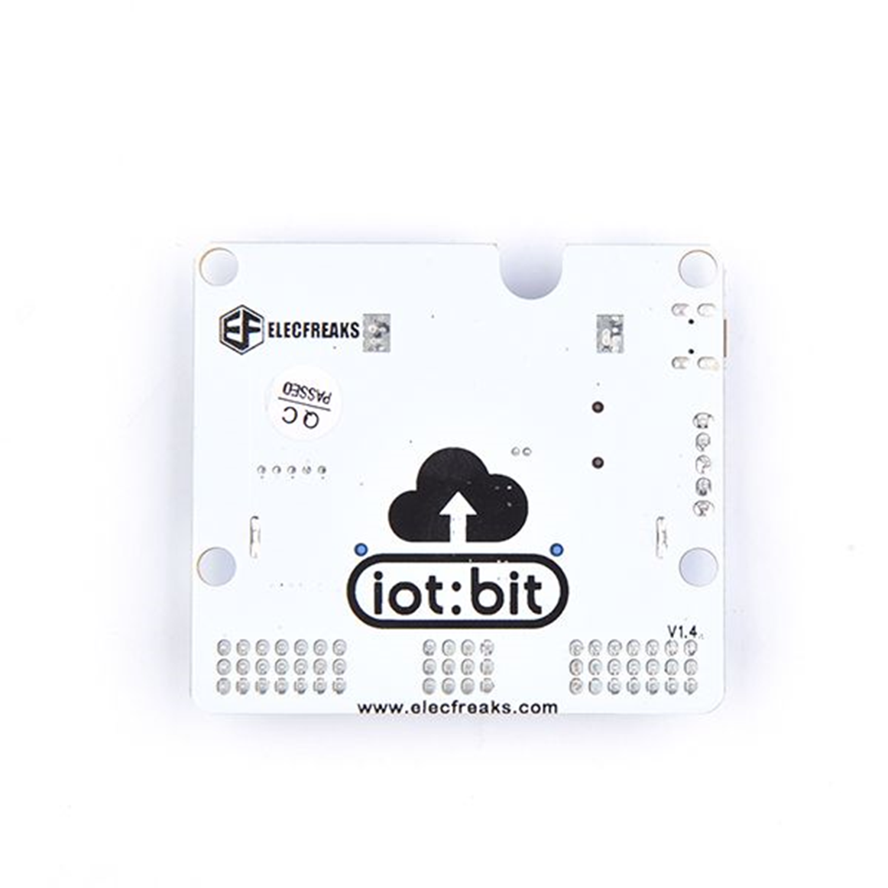
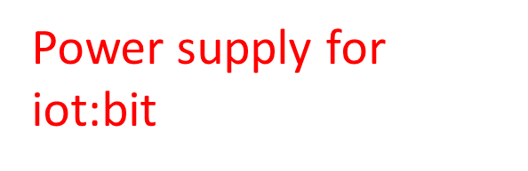


iot:bit
Switch
S = Data pin
V = 3.3v power
G = GND

Slide 5
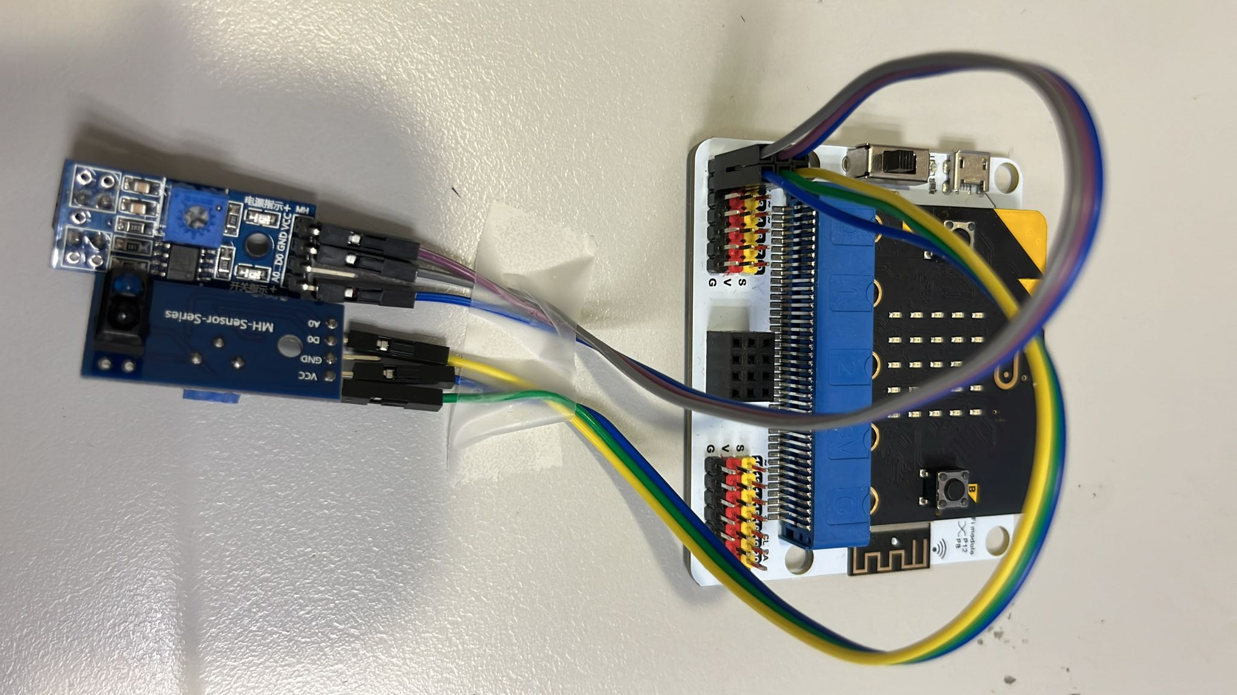
iot:bit
S = Data pin
V = 3.3v power
G = GND

Slide 6
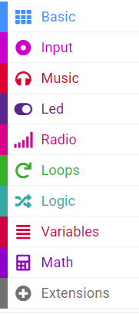
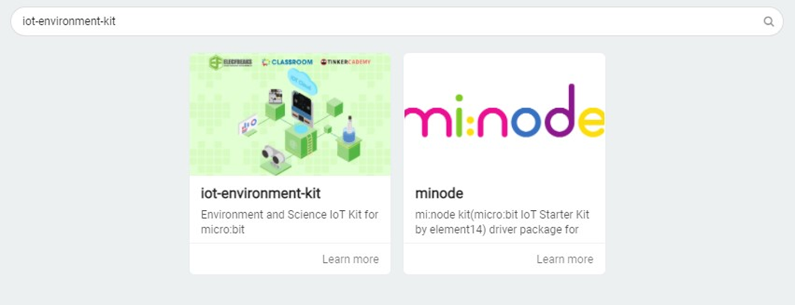



MakeCode extensions
Iot-environment-kit

Slide 7
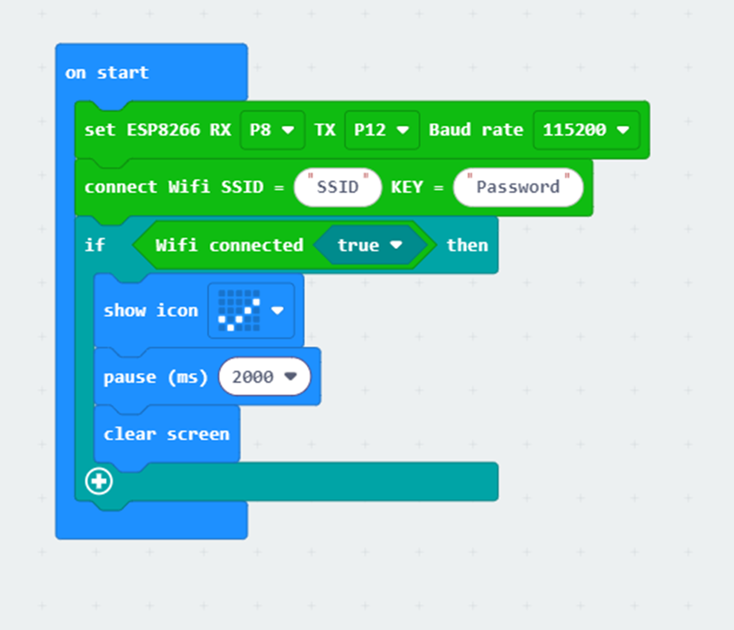
iot:bit WiFi setting
拖入這些block。
然後輸入 Wi-Fi 名稱和密碼。

Slide 8
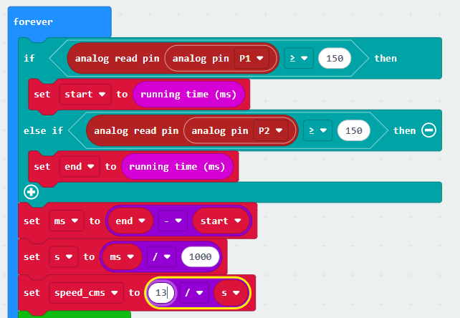
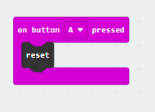
Microbit coding
拖入這些block。
軌道的長度（cm），可以視乎情況改變

Slide 9
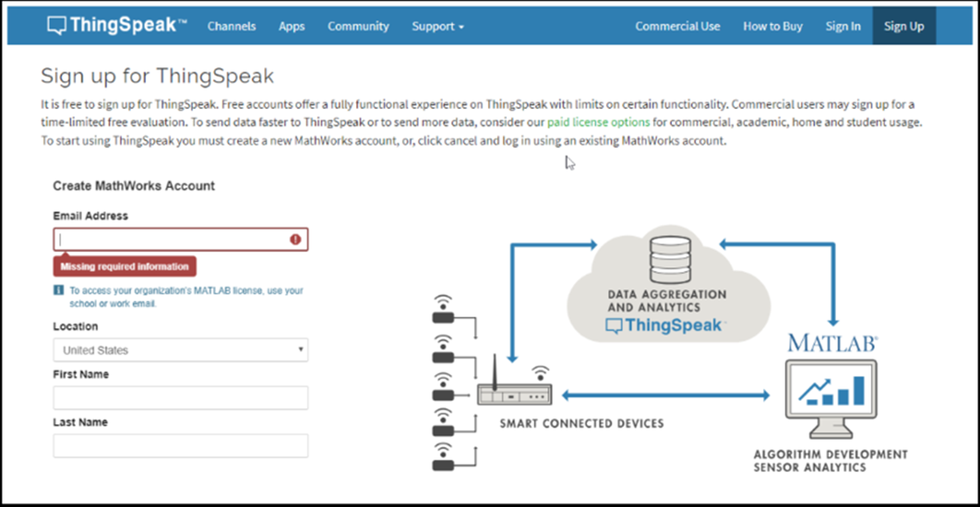
ThingSpeak Set Up
Step 1: 登入https://thingspeak.com

Slide 10
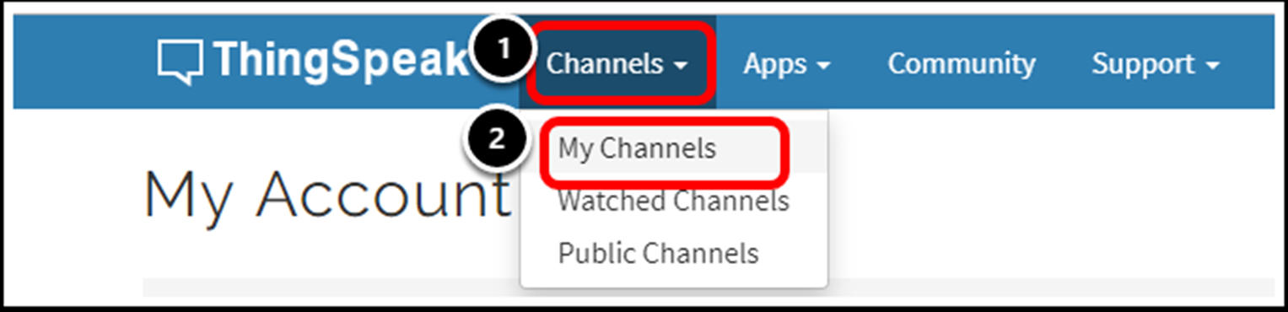
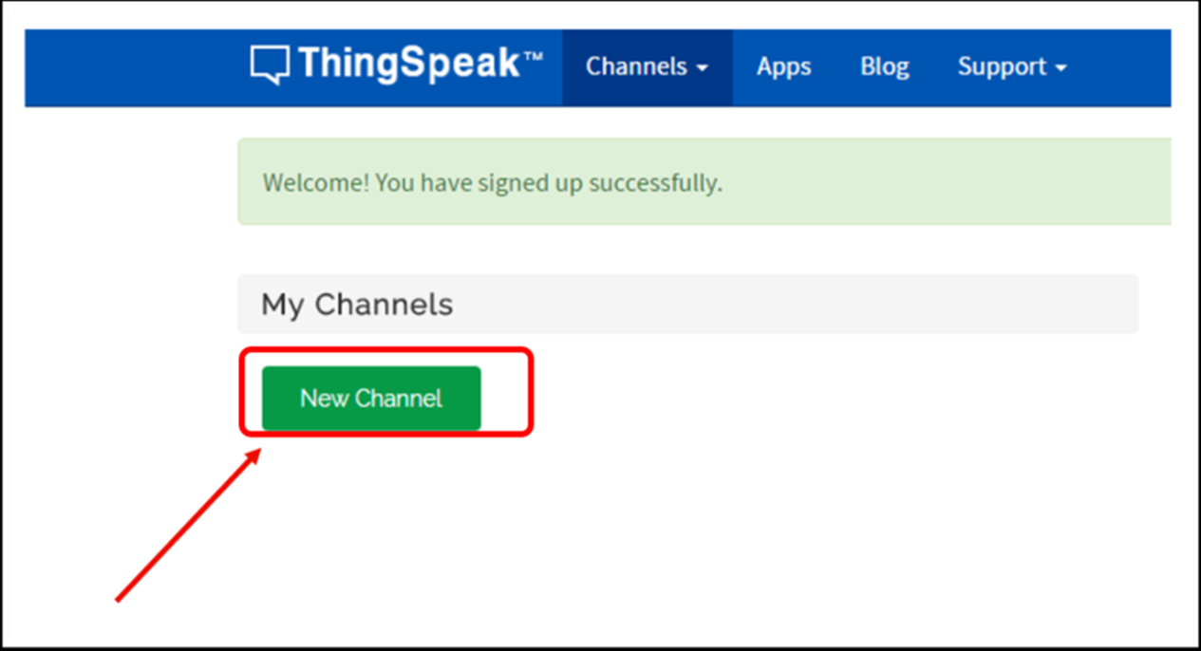
ThingSpeak Set Up
Step 2: 登入“ThingSpeak”後，點擊頻道並選擇“My Channels”
Step 3: Click New Channel

Slide 11
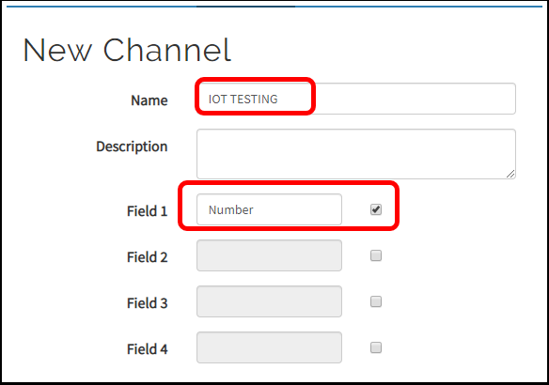


ThingSpeak Set Up
Step 4: 輸入Channel名稱，、並在“Field”中新增名稱以記錄數據，然後Save Channel

Slide 12
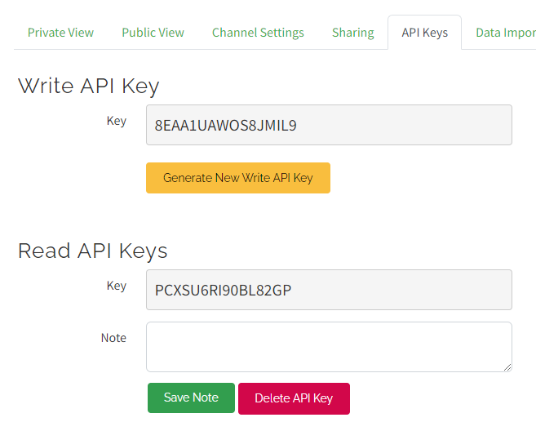

ThingSpeak Set Up
Step 5： Copy API Key

Slide 13
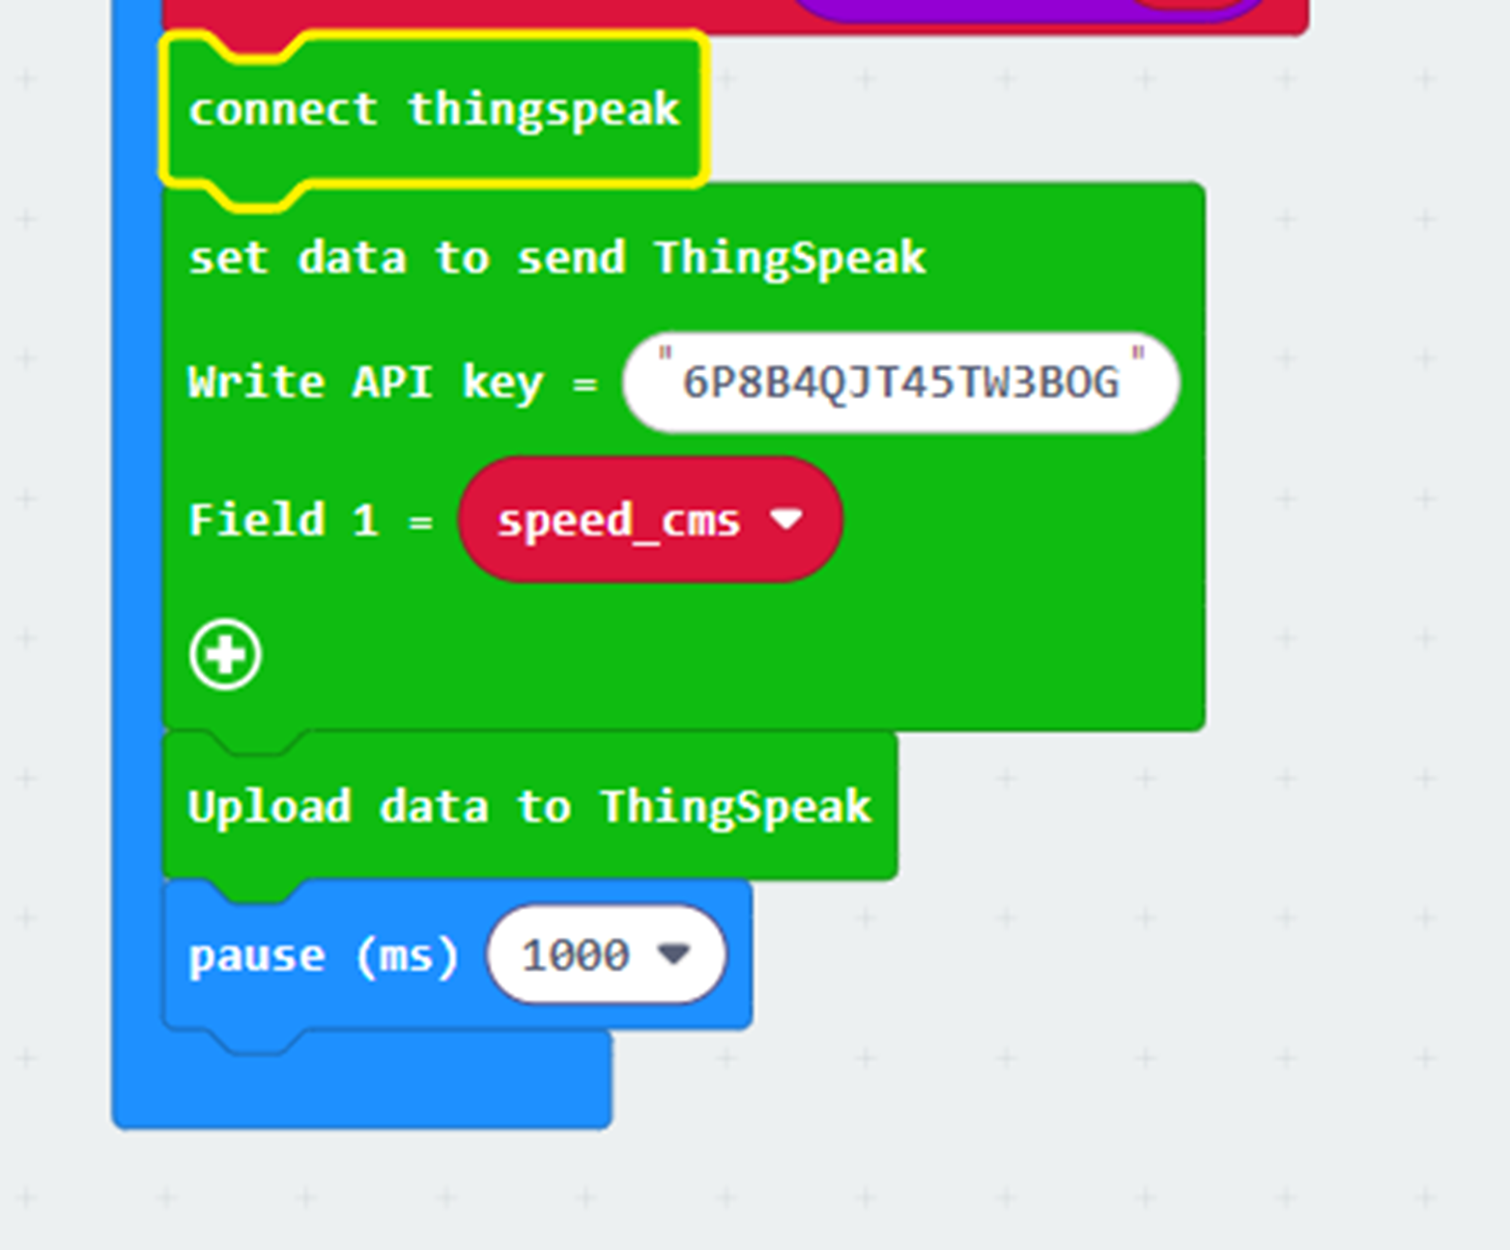

ThingSpeak Set Up
Step 5： 拖入這些block
Paste API Key in Makecode

Slide 14
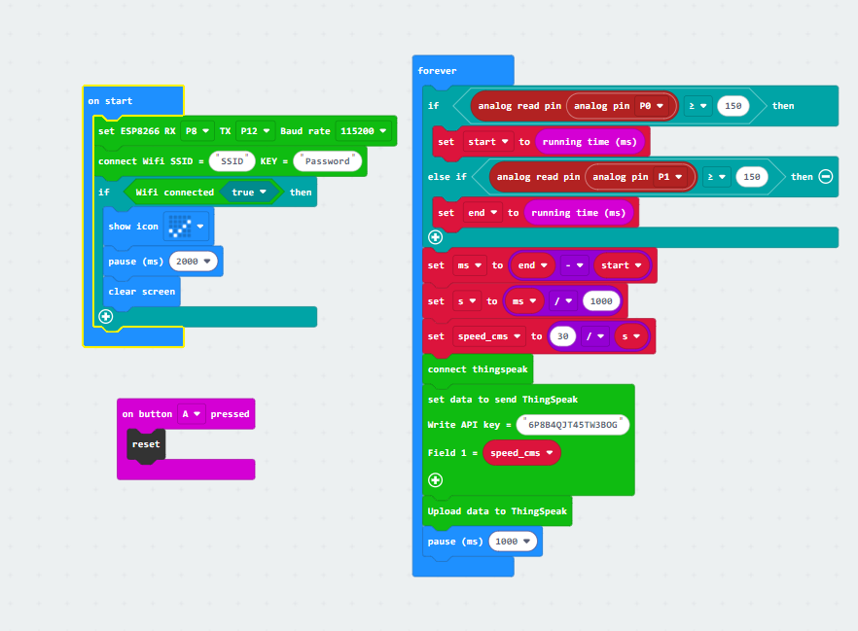

完整coding
https://makecode.microbit.org/S15150-93472-97379-38663

Slide 15
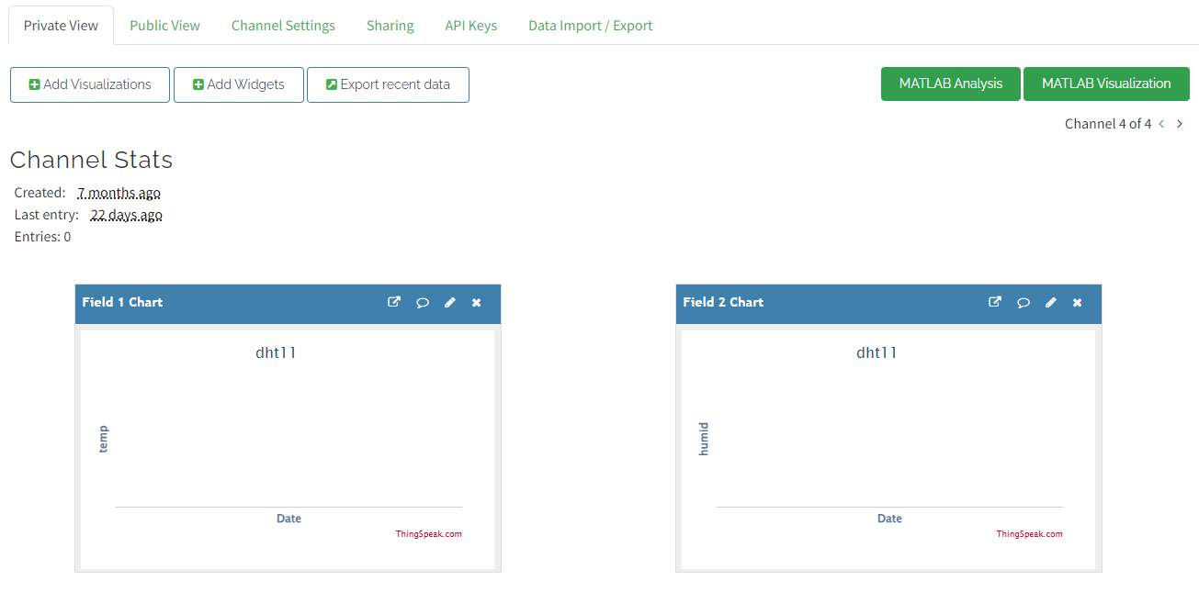
ThingSpeak Set Up
Step 6： Click Private View 睇結果

Slide 16
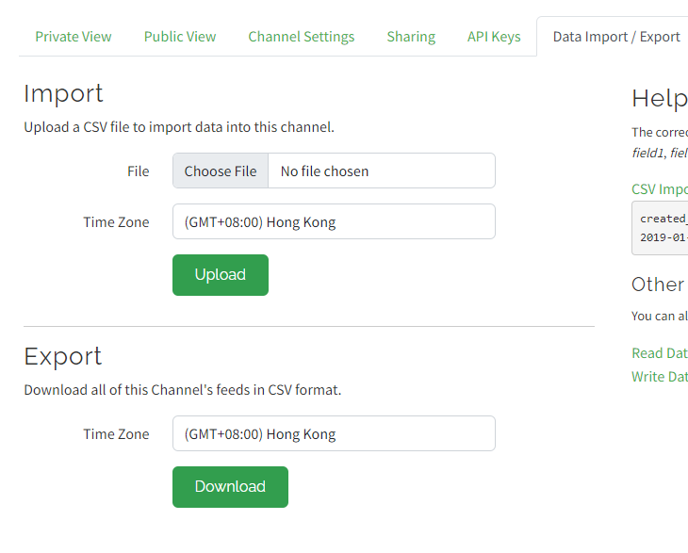

ThingSpeak Set Up
Step 7： Click Download

Slide 17
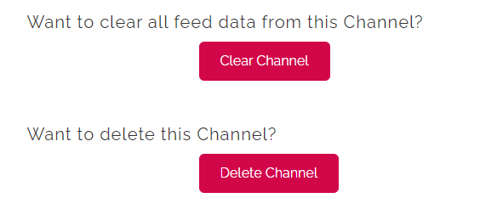
ThingSpeak Set Up
係Channel Settings 可以Clear Data，
或者將成個 Channel delete

Slide 18
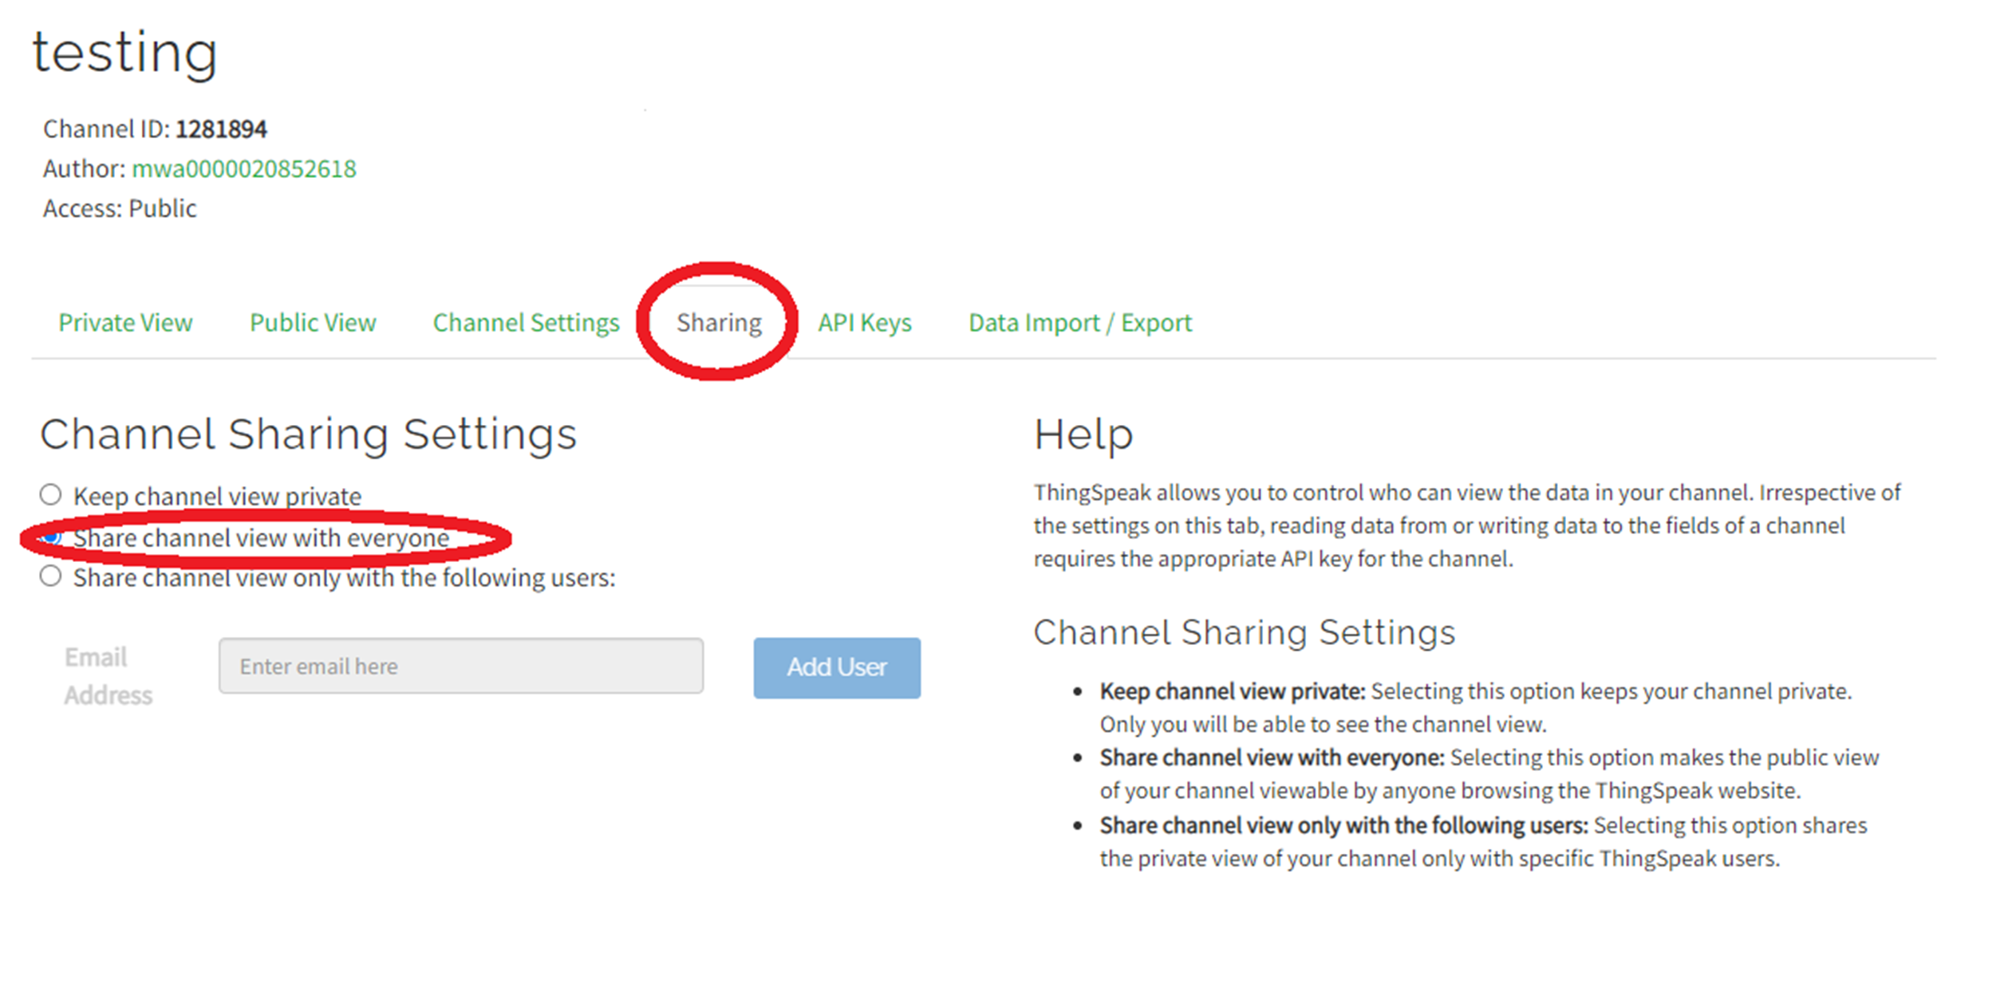
ThingSpeak Public View Sharing
Step 5： Paste API Key in Makecode

Slide 19
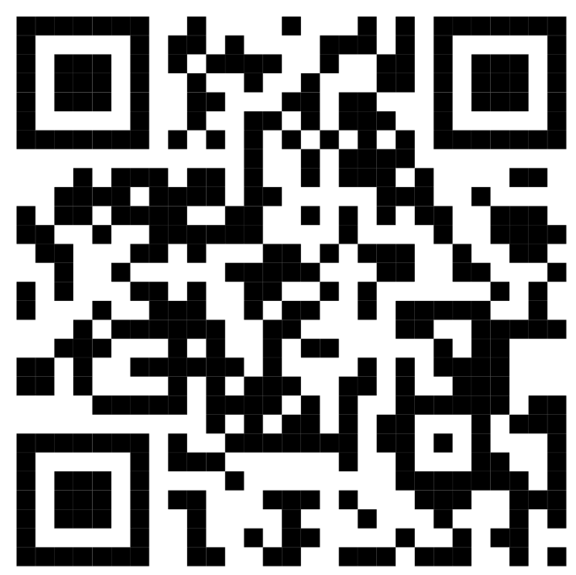
請掃描以下二維碼填寫意見表,
謝謝！
School-based PD Workshop - Application of IoT:bit for Data logging
Speaker: Ms. Lam Hong Ching Anastasia
Research Assistant I
https://docs.google.com/forms/d/e/1FAIpQLSeWBtglyyjCJDBebukcRVAx7fpMG8eet_0xSc-D0ggOT0coEg/viewform?usp=sf_link

